Slide 1







Discover

Slide 2
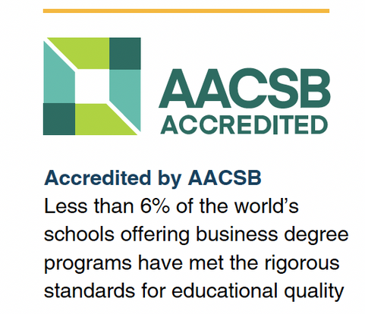



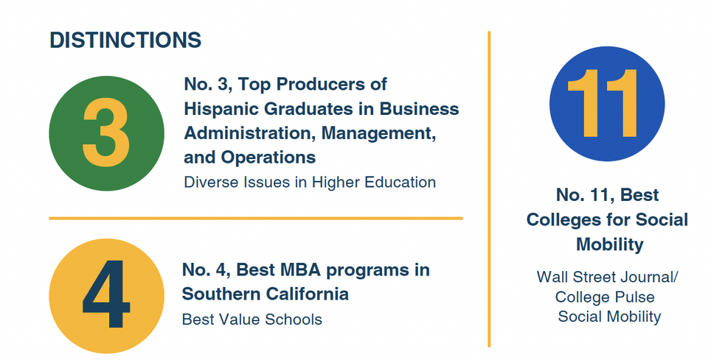


Accreditation & Rankings
AACSB graduates are sought by top, global organizations that only recruit from AACSB-accredited schools
AACSB-accredited business schools have high employability, degree satisfaction, and career advancement rates (according to AACSB, based on information collected independently by GMAC®, NASBA, and AACSB International)

Slide 3

Academic Degrees
Bachelor of Science in Business Administration
Options Include:
Accounting
Computer Information Systems
E-Business
Finance, Real Estate, and Law
Marketing Management
International Business
Management and Human Resources
Technology and Operations Management

Slide 4
Academic Degrees
Master’s Degrees
Master of Business Administration (MBA)
MS in Accountancy, General and Accelerated (MSA)
MS in Business Analytics (MSBA)
MS in Digital Marketing (MSDM)
MS in Digital Supply Chain Management (MSDSCM)
MS in Financial Analytics (MSFA)
MS in Human Resources Leadership (MSHRL)
MS in Information Security – Online and In Person (MSIS)

Slide 5

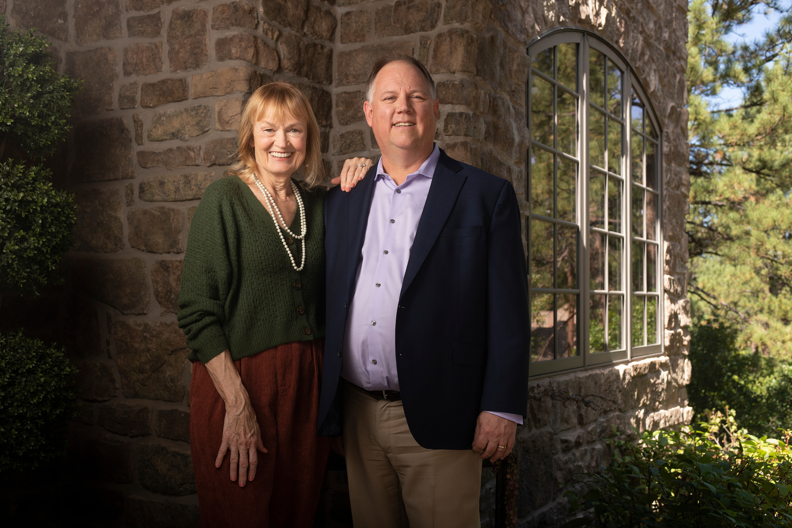


Singelyn Graduate School of Business
Cal Poly Pomona has received a $12.5 million philanthropic investment from alumni David and Ruth Singelyn to expand the College of Business graduate program, which has been formally named the Singelyn Graduate School of Business- the only named CSU graduate program in California.
Drs. David (84’ accounting and computer information systems) and Ruth Singelyn (‘84 computer information systems)

Slide 6

Singelyn Graduate School of Business
WE HELP FUTURE BUSINESS LEADERS ACHIEVE THEIR POTENTIAL THROUGH AFFORDABLE, MARKET-RELEVANT, AND EXCELLENT GRADUATE BUSINESS PROGRAMS TAUGHT BY EXCEPTIONAL FACULTY MEMBERS.
Affordable: Tuition is considerably less than competitors. This is especially true for many international students who learn they can earn an AACSB accredited, STEM designated degree.
Relevant Curriculum: Students are prepared for the ever-changing world of business. The curriculum is reviewed regularly by advisory boards who are industry leaders, across all programs, to ensure grad students are learning the most current and tech forward practices.
STEM-Designated (Select Grad Programs): Graduates of our STEM-designated programs can expect job availability and longevity when entering STEM oriented positions. Further, international students on F1 student visas earning STEM designated degrees can apply to OPT in their respective fields for up to 36 months in the U.S. following graduation.

Slide 7
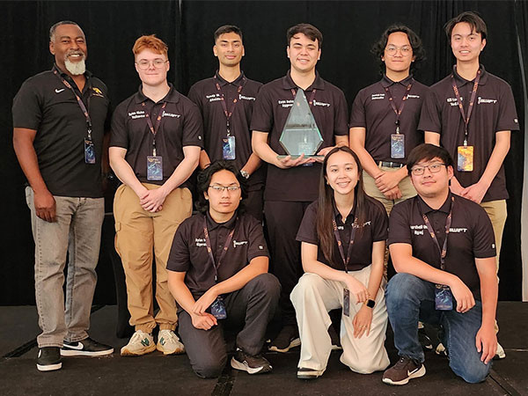

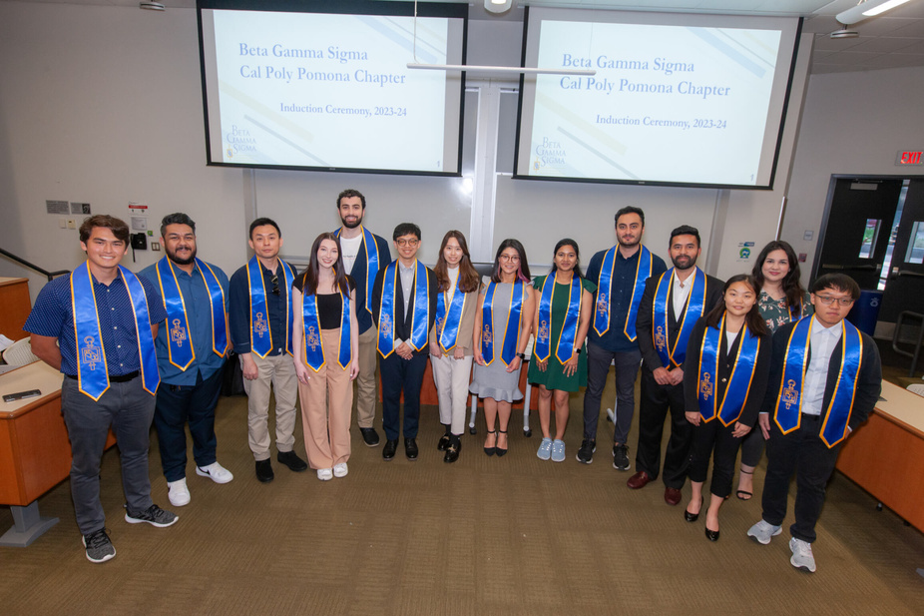

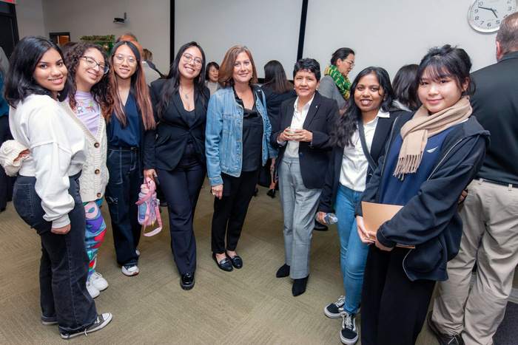

6 CENTERS OF EXCELLENCE
Singelyn Center for Innovative Analytics
Center for Entrepreneurship and Innovation
Center for Customer Insights and Digital
Marketing Mitchell C. Hill Center for Digital
Innovation California Center for Cyber Risk
Center for Consultative Sales
22+ Student Clubs and Organizations
including Student Managed Investment Club, International Business Association, Finance Society, and many more!

Slide 8
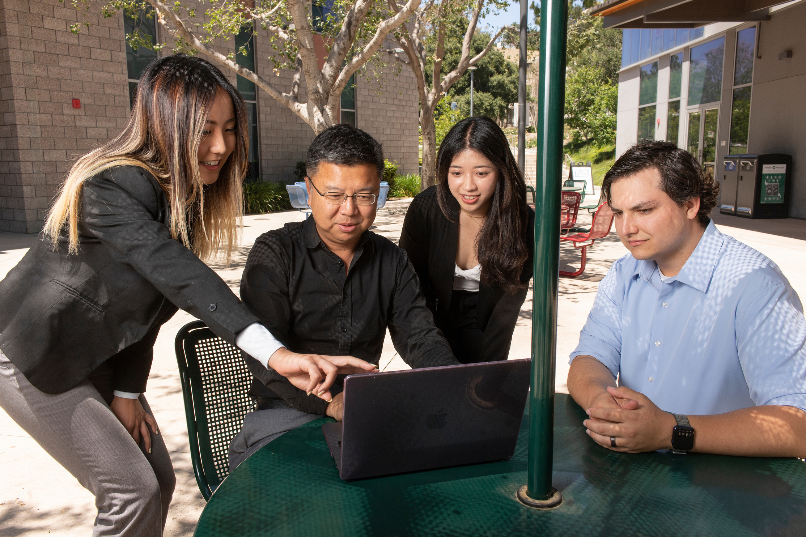
Faculty & Research
85 full time faculty
Faculty publish in top journals including Production and Operations Management; Auditing; Journal of Business Ethics; Journal of Behavioral Finance; Journal of Real Estate Finance and Economics; International Journal of Marketing Studies; Computers in Human Behavior; and more!

Slide 9



Where our alumni work

Slide 10


Hands On Learning
True to the polytechnic experience, the College of Business Administration combines a cutting-edge business education with meaningful, real-world experiences, helping students apply what they learn in the classroom as well as develop a set of essential skills: creativity, leadership, and team-building.

Slide 11

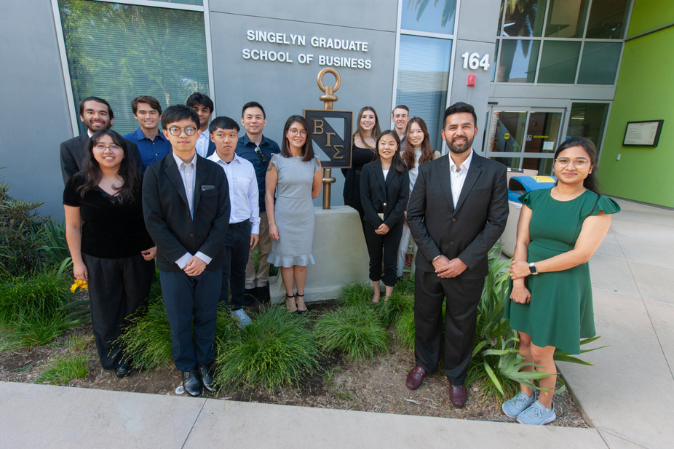
Beta Gamma Sigma
Beta Gamma Sigma (BGS) is a premier international honor society that recognizes the highest performing students (top 10% of the undergraduate students at the CBA) at the top 5% of the business schools in the world (as accredited by the Association to Advance Collegiate Schools of Business, AACSB International). BGS is a Business Honor Society — not a student club or a student fraternity, and it is invite-only, so it is a special honor for students who are invited and accepted. BGS is founded on a set of three principles; honor, wisdom, and earnestness, which serve as pillars for everything the society does.

Slide 12

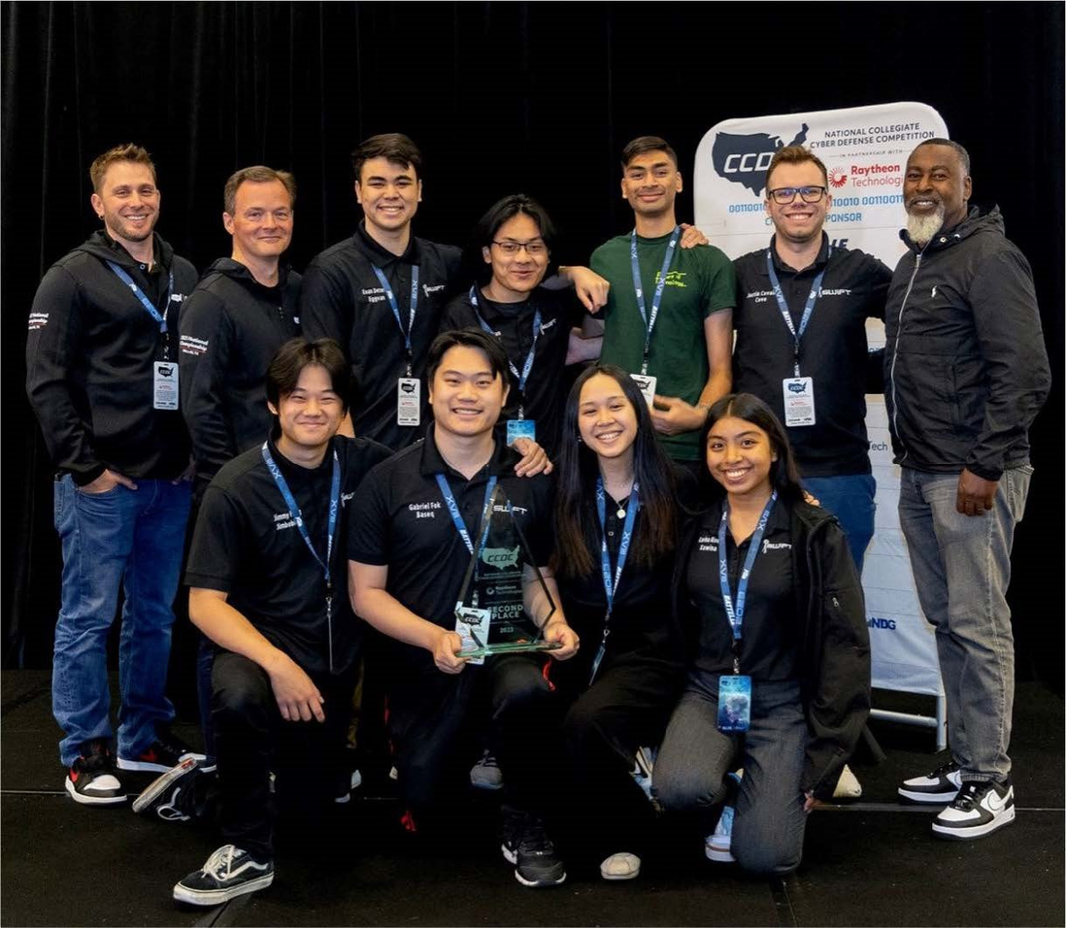


Led by CBA, Cal Poly Pomona has been designated a
NATIONAL CENTER OF ACADEMIC EXCELLENCE IN CYBERSECURITY
by the National Security Agency and other federal agencies since 2005
Cal Poly Pomona’s student-led cybersecurity teams have established a national standard for excellence, winning first place at the
2023 Collegiate Penetration Testing Competition
and second at the 2023 National Collegiate Cyber Defense Competition (CCDC)

Slide 13

Location, Location, Location!
Proximity means access: Cal Poly Pomona is ideally situated at the nexus of Los Angeles, Orange, San Bernardino, and Riverside counties.
Our campus is located near Fortune 500 companies, global tech giants, and beaches and entertainment, providing the perfect backdrop for business students looking to balance work and play.
Driving distance to:
Disneyland
Dodger Stadium
Downtown Los Angeles
Palm Springs
Las Vegas
plus so much more!

Slide 14


Why choose CBA?
Accredited
Hands-On Learning
Diverse Programs
Strong Industry Connections
Faculty Expertise
Student Organizations
Entrepreneurship Focus
Global Perspective
Student Success
This could be YOU!

